Slide 1
CONDITIONAL TENSE
ZERO CONDITIONAL

Slide 2



WHAT HAPPENS IF….. ?
If we mix yellow and red, we get orange.

Slide 3
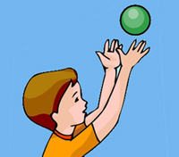
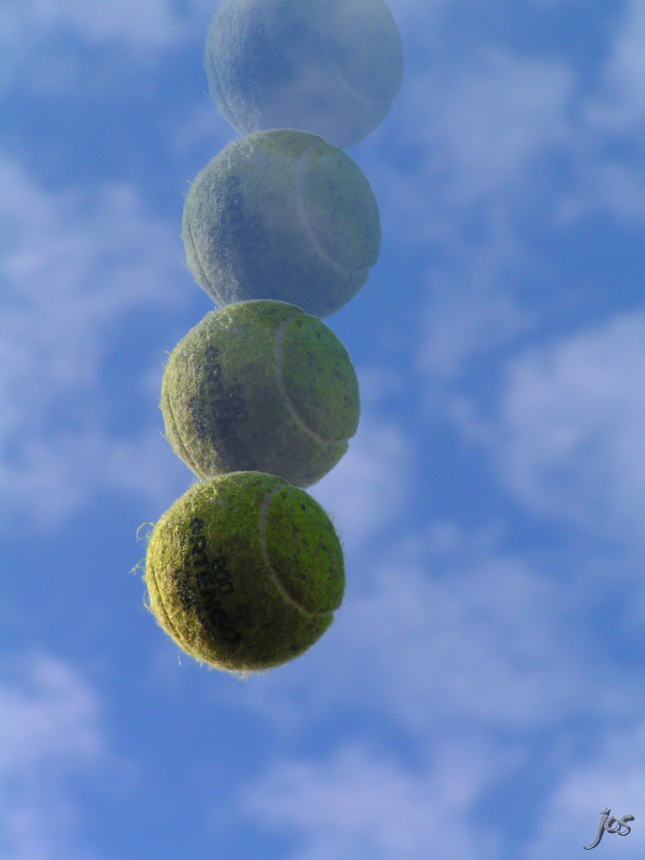
WHAT HAPPENS IF….. ?
If you throw a ball in the air, it falls down

Slide 4
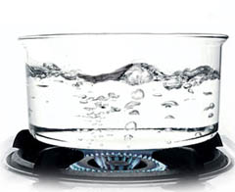
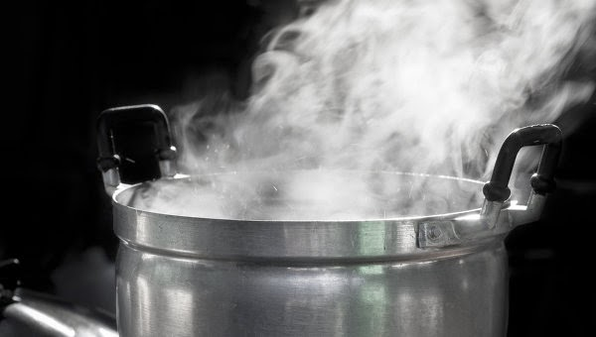
WHAT HAPPENS IF….. ?
If you boil water, it turns into steam

Slide 5
ZERO CONDITIONAL SENTENCES
IF WE MIX YELLOW AND RED, WE GET ORANGE
IF YOU THROW A BALL IN THE AIR, IT FALLS DOWN
IF YOU BOIL WATER, IT TURNS INTO STEAM.

Slide 6
GRAMMAR RULES
IF WE MIX YELLOW AND RED,
(CONDITION )
WE GET ORANGE
(RESULT )

Slide 7
GRAMMAR RULES
IF YOU THROW A BALL IN THE AIR,
(CONDITION )
IT FALLS DOWN
(RESULT )

Slide 8
GRAMMAR RULES
If we mix yellow and red, we get orange.
we get orange if we mix yellow and read.

Slide 9
Zero conditional sentences
If we mix yellow and red,
(present simple)
we get orange
(present simple)

Slide 10
Zero conditional sentences
If you throw a ball in the air,
(present simple)
it falls down
(present simple )

Slide 11
Zero conditional sentences
If you throw a ball in the air, it falls down
When you throw a ball in the air, it falls down
It water gets too cold, it freezes
When water gets too cold, it freezes

Slide 12
REMEMBER THAT…
We use if or when+ present simple + present simple for zero conditional
Zero conditional speaks about facts and statements that are always true.

Slide 13


LET’S PRACTICE

Slide 14
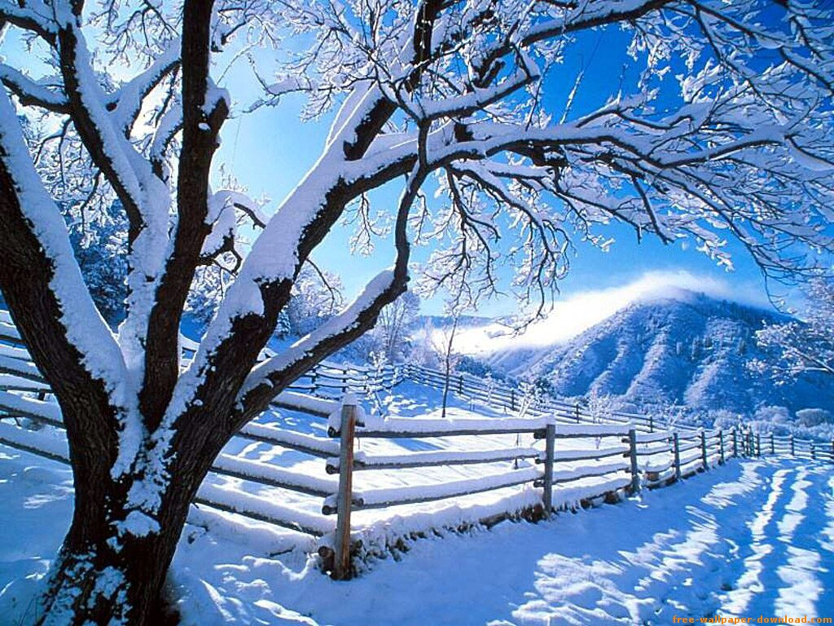
Put the verbs in the correct form :
If Winter ______, the temperatures begin to rise.
Ends
End

Slide 15

Put the verbs in the correct form :
When spring arrives , everything in the garden_______ to grow.
starts
start

Slide 16
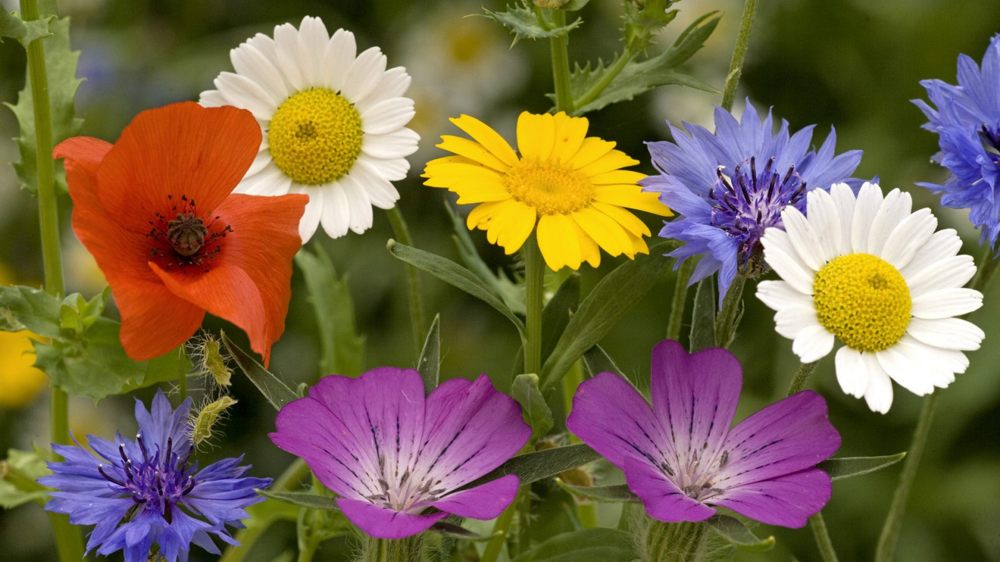
Put the verbs in the correct form :
When summer approaches, flowers _______ everywhere.
appears
appear

Slide 17
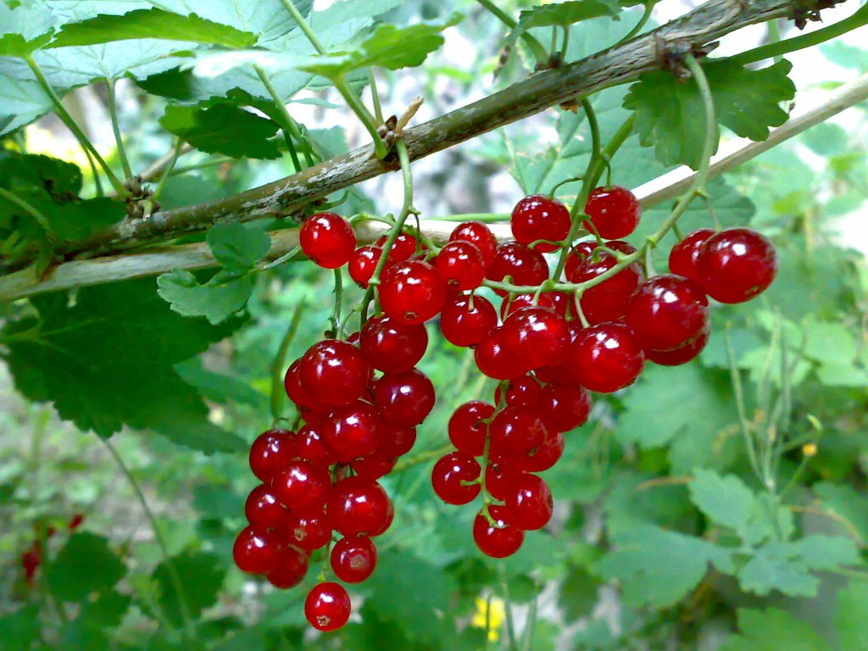
Put the verbs in the correct form :
When summer _________ to autumn, trees produce their fruits.
changes
change

